Slide 1
What a Load of Barnacles! A Spatial Population Genomic Simulation of the Pacific Acorn Barnacle in Coos Bay
Alexandra Bangs Angel Rivera-Colon, Jiseon Min, Peter Ralph
Kern Ralph Co-lab
SPUR Symposium
August 22, 2024
Notes:
Hello! My name is Alex Bangs, I work with the Kern Ralph Co-Lab, and today I’m gonna talk to you about simulating barnacles

Slide 2
Looking at the changes in the genome across group of organisms
Seeing how the population and their genome varies across a landscape
Using computers to model various ecological and evolutionary scenarios
What a Load of Barnacles! A Spatial Population Genomic Simulation of the Pacific Acorn Barnacle in Coos Bay
The Pacific acorn barnacle (Balanus glandula) is the organism we’re studying
The Coos Estuary is the landscape we’re studying the Pacific acorn barnacle in
Notes:
But, before I do, let’s break down this title.
For this project, simulations means computational models focusing on ecological and evolutionary scenarios.
Specifically, we’re simulating population genomics, meaning we’re looking at the changes in the genome across a group of organisms
On top of this, we’re seeing how this population and their genome vary across a defined landscape
Our group of organisms is a population of the Pacific acorn barnacle…
and our defined landscape is the coos estuary

Slide 3
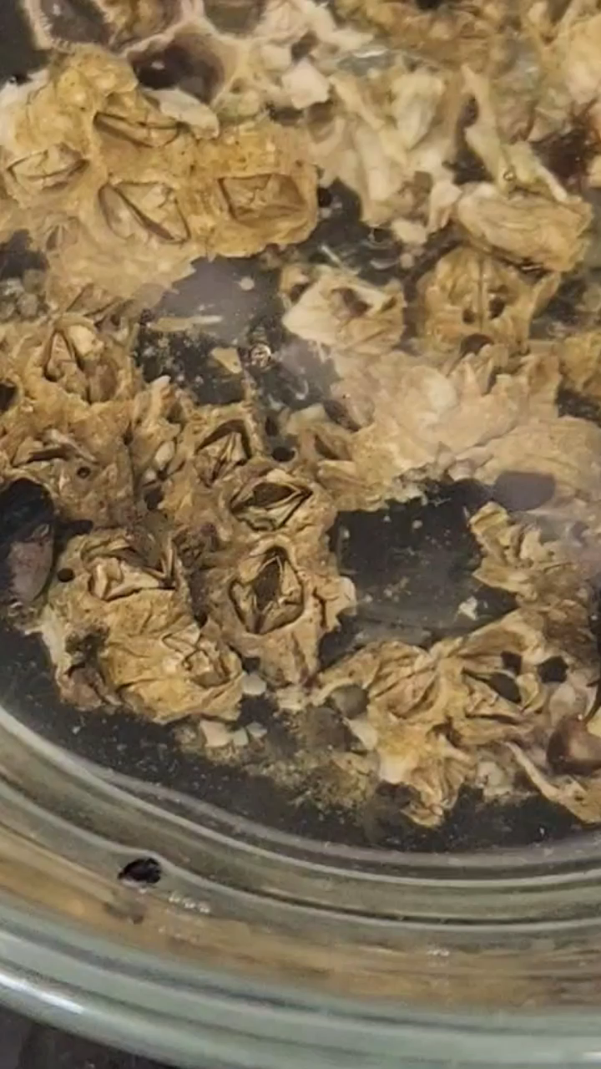
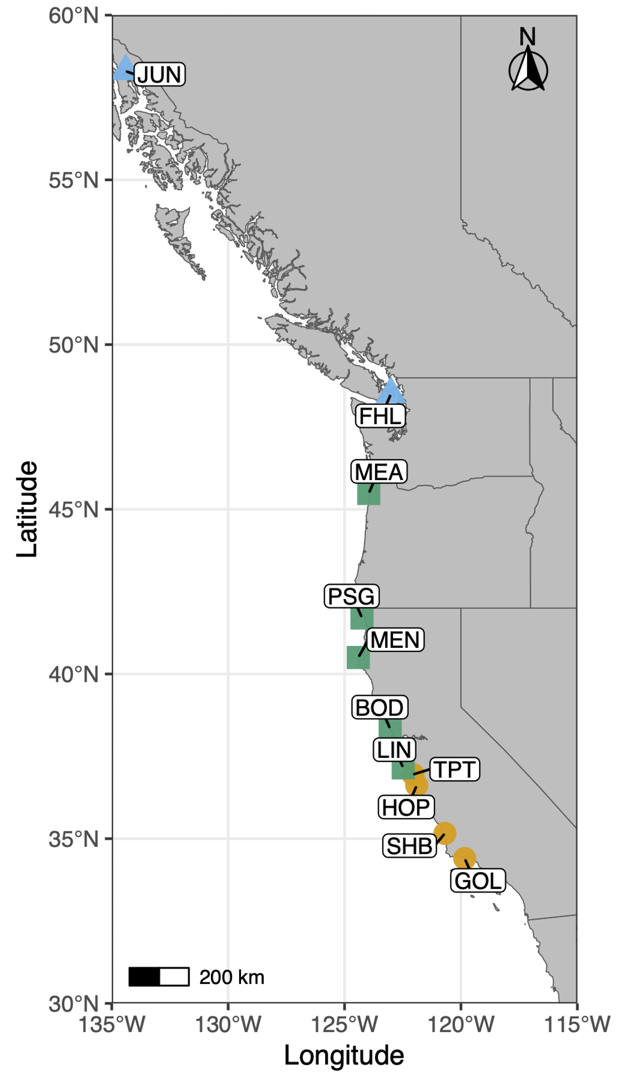
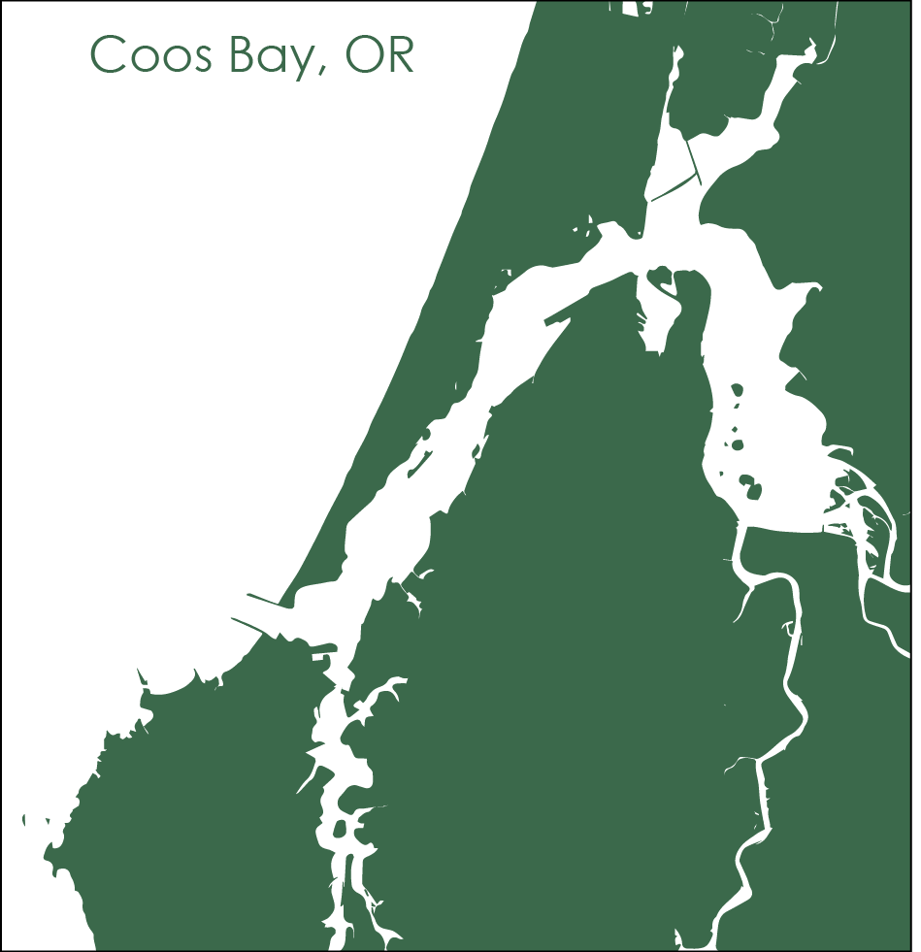
The Pacific Acorn Barnacle in the Coos Estuary
Build the model
Credit to Erin Jezuit, 2024
Notes:
0. For those of you who don’t spend all day studying barnacles, here’s a little snapshot of what this species looks like
This neat organism is found across the Pacific coast of North America, from Baja California up to Alaska
My lab is examining the interesting genetic diversity found between these different populations (gesture to middle map)
And as a part of this larger research project, I am focusing on simulating a specifc population of barnacles within Coos Bay

Slide 4
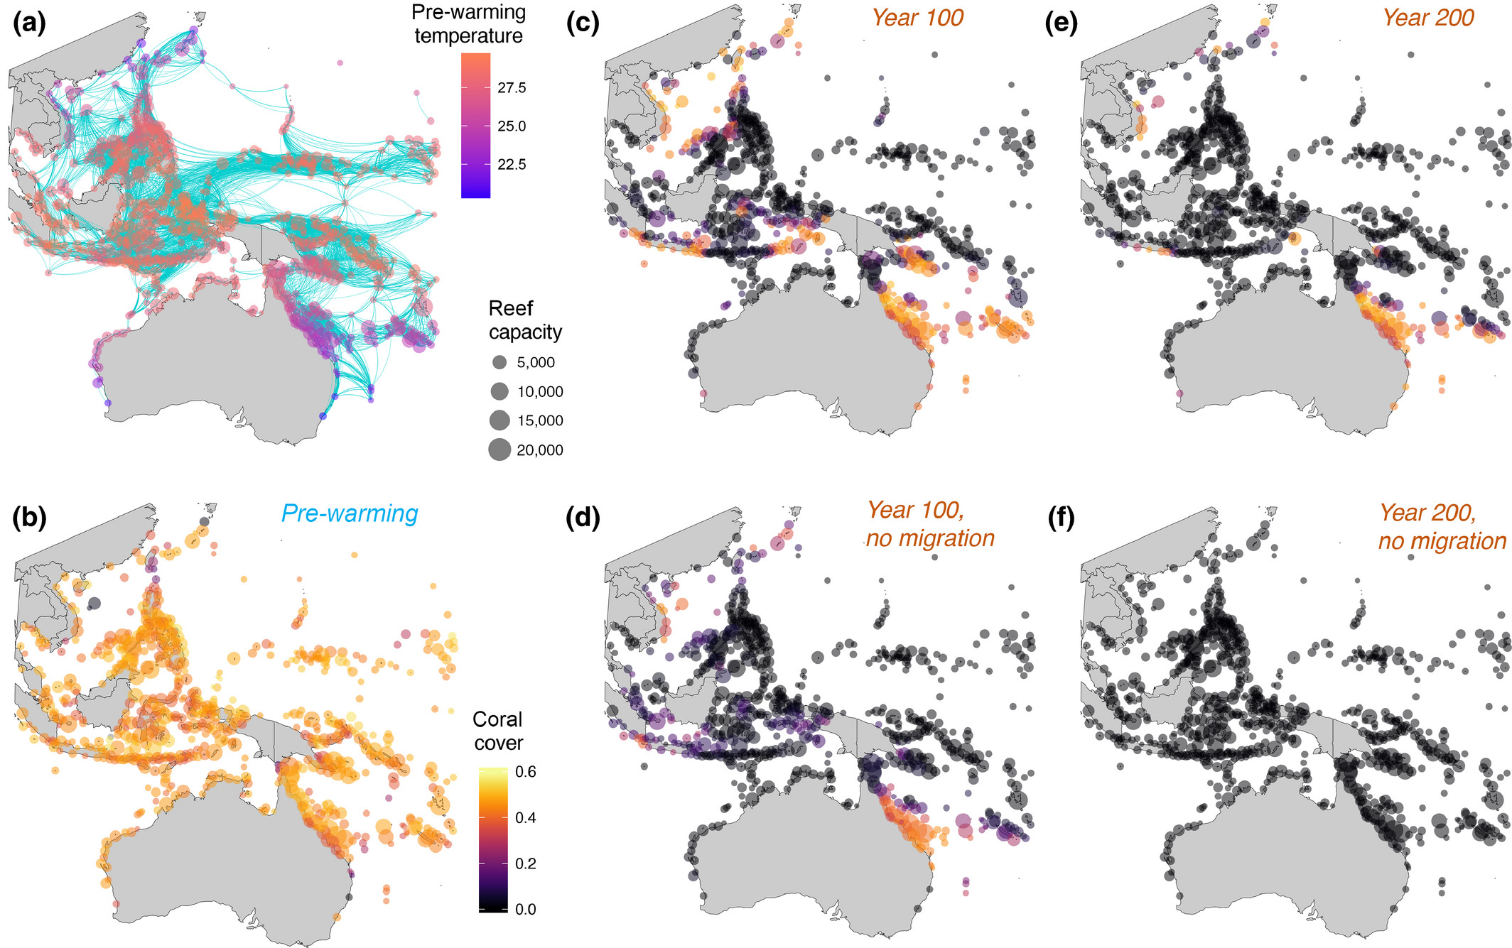
Why Are Simulations Important? An Example
Check our assumptions
Conduct Experiments
(Matz et al., 2020)
Notes:
But why should you care about simulations like this one?
Well, they help us check our assumptions about how biology, genomics, and evolution
And, they allow us to conduct experiments about the impact of long-term changes on populations, which we can apply to conservation of endangered species, invasive species management, and proper maintenance of economically-important species
For example, this is simulation built by Matz et al. with the same software I use for my simulation. It models coral migration scenarios in the Indo-Pacific as a response to oceanic warming under Anthropogenic Climate Change
We can apply simulations like this to help us make the best decisions about coral conservation, including how and where we should focus assisted migration efforts.

Slide 5
Objectives
Build a model describing the biology of the Pacific acorn barnacle (Balanus glandula) in the Coos Estuary
Use the model to simulate how variation on short- and long-term scales impacts population fitness, demography, and genetic isolation on this system
Examine how populations adapt to changing environments when migration is restricted
Notes:
Let’s talk about the goals and applications of this project
First, we need to build a foundational model accurately describing the biology of these barnacles in this environment
Then, we want to implement short- and long-term variation and see how it will impact population fitness, demography, and genetic isolation
And we’re doing this with the overarching goal to examine how populations adapt to changing environments—due to things like climate change—when their movement is restricted.
End goal for this project
Barnacles—relative to species with greater mobility—aren’t able to quickly migrate in response to environmental stressors.
We study B. glandula to see how a population adapts to changes in their environment as a result of Climate Change
We can also look at how these scenarios will impact spatial distribution, genetic diversity, and
We use this simulation to examine how variation on short- and long-term scales impacts population fitness, demography, and genetic isolation on this system. We focus on B. glandula to examine how populations adapt to changing environments when migration is restricted in sessile adults.

Slide 6
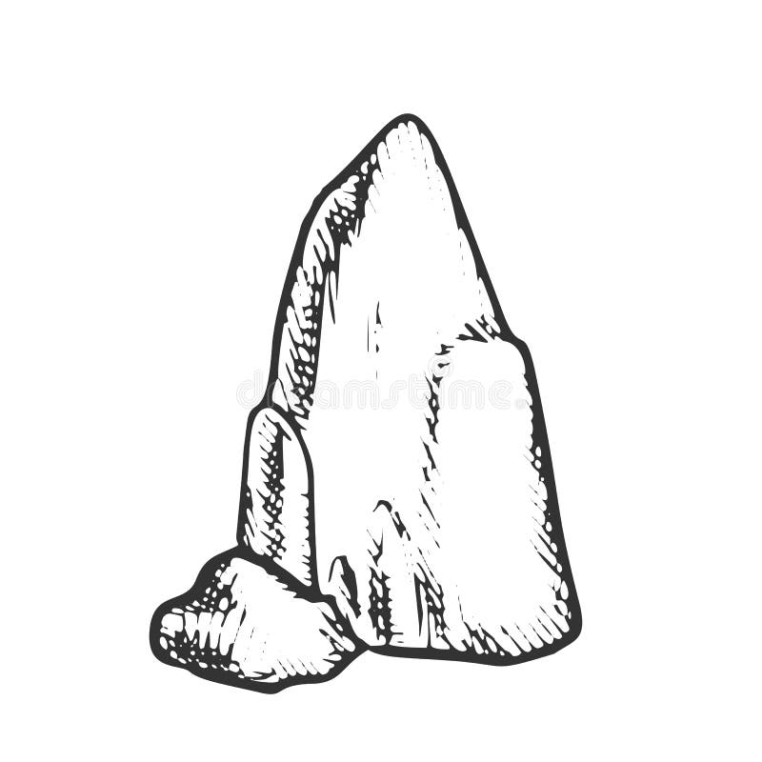
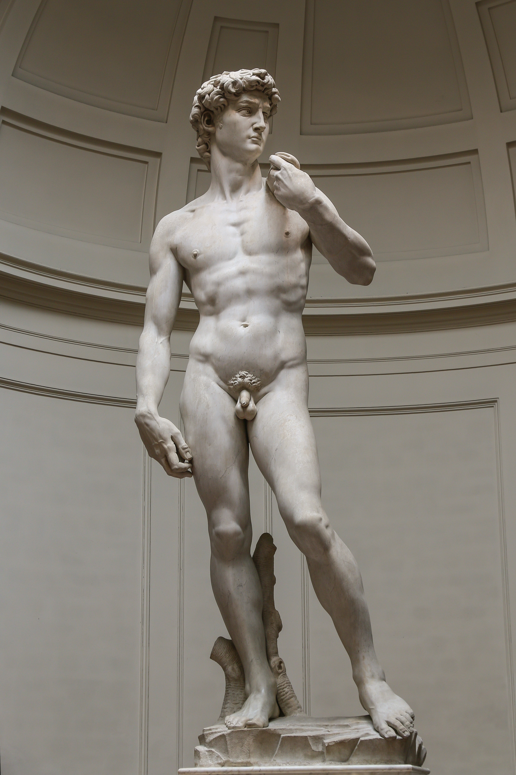
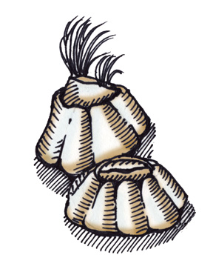
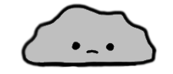
Build the model
Sculpting our organism
Notes:
As I just mentioned, the first step for this project is building a brand-new model
I like to describe this process as sculpting, because
Just as the sculptor starts with a block of marble…
the simulator starts with an amorphous blob of an organism.
The sculptor chisels away at the block, spending endless hours to create a masterpiece
…And the simulator sculpts the blob, spending weeks of a summer to make a masterpiece… of a barnacle
So, what does sculpting a barnacle look like? (Next Slide)

Slide 7
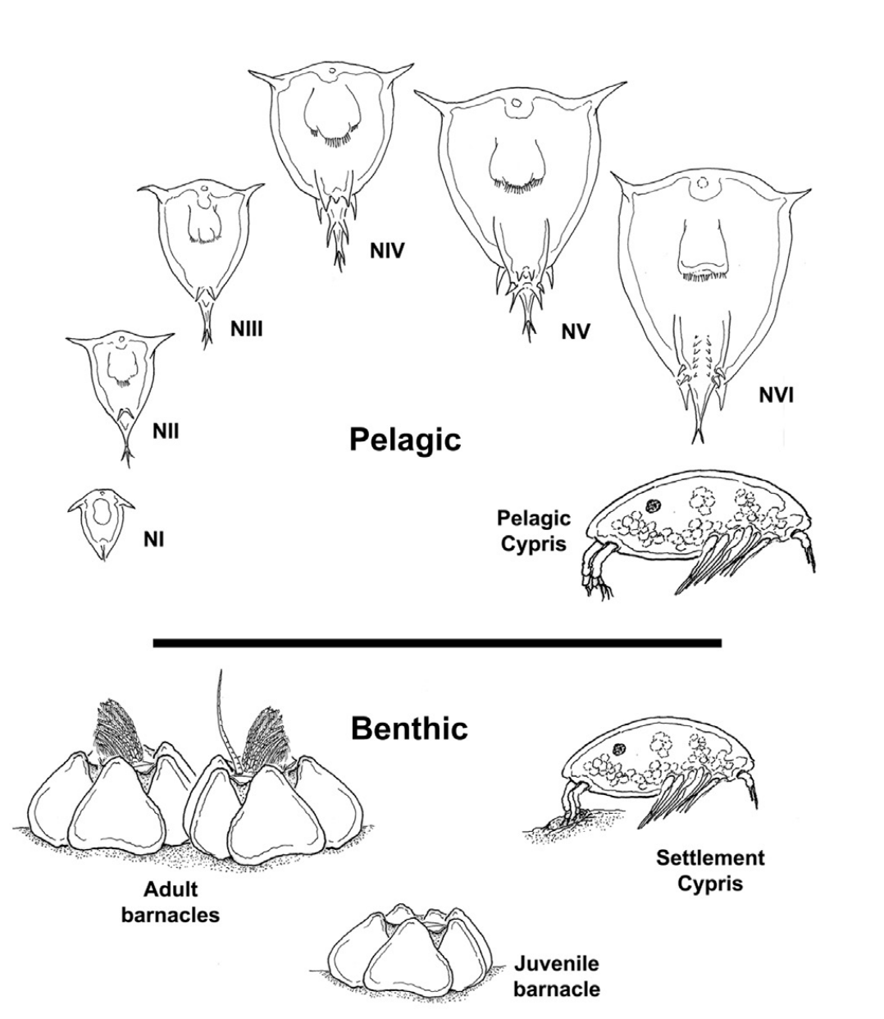
Build the model
What do we have to account for?
~3-4 weeks
~7-9 years
(Hiebert and Jarvis, 2015)
~1 year
(Suárez-Morales, 2015)
Notes:
Well, first we must model their discrete life stages
Barnacles start as planktonic larvae but spend less than a month in the water column before finding somewhere to settle for the rest of their life.
Settled barnacles spend time growing before reaching reproductive maturity, at which point they start producing multiple broods of offspring each year. The lifespan of settled Pacific acorn barnacles is about 8-10 years
In addition, we know there’s a time component regarding when reproduction, dispersal, and settlement happens, but I’ll get into that more in a bit
Important things to introduce. Don’t go too in depth; if people have questions, they’re free to ask afterwards
Population size
Carrying Capacity
Life stages
Reproduction
Spatial mate choice
Dispersal as Larvae
Settlement Process
Spatial Competition

Slide 8
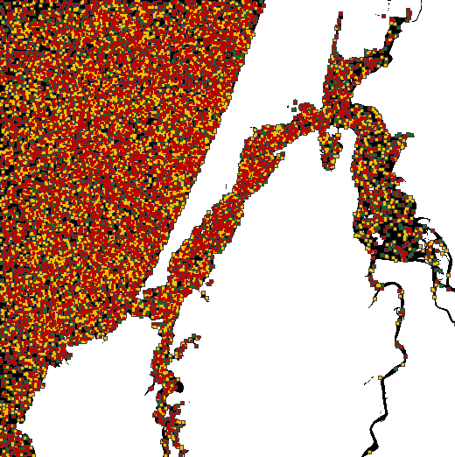
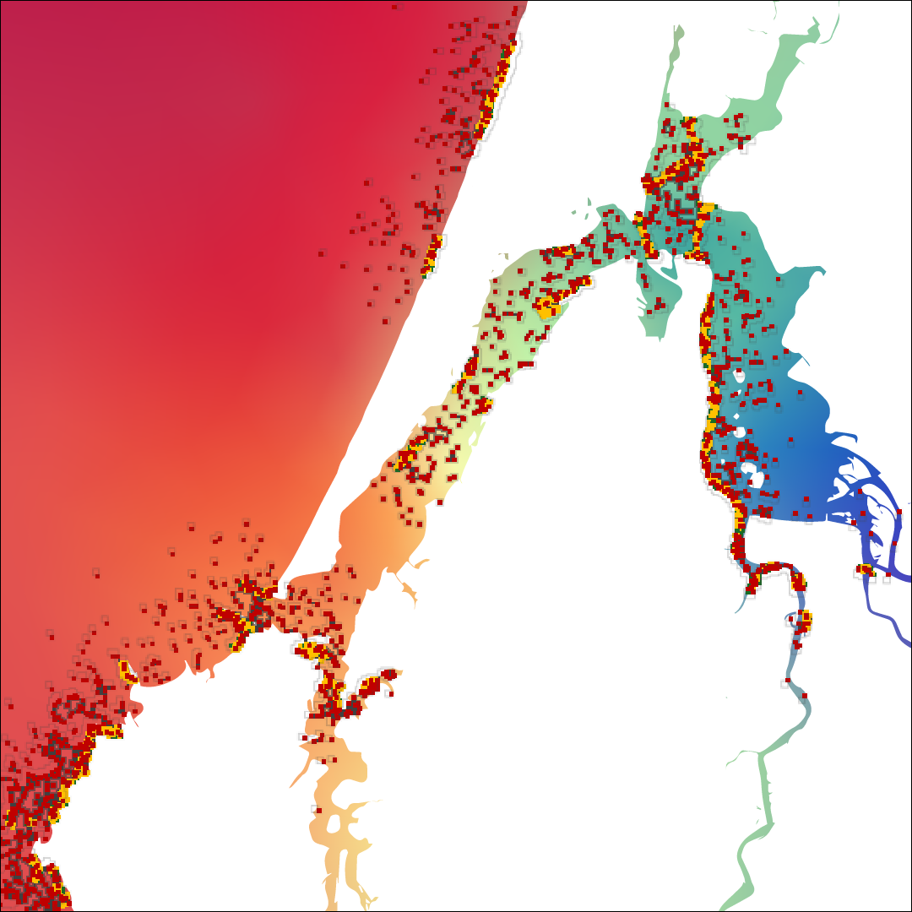
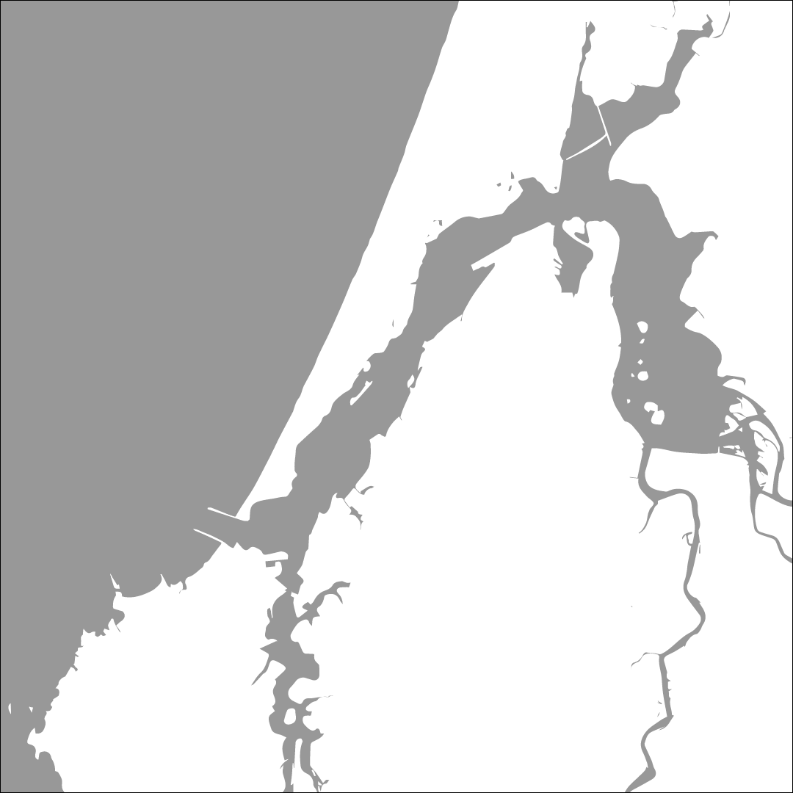
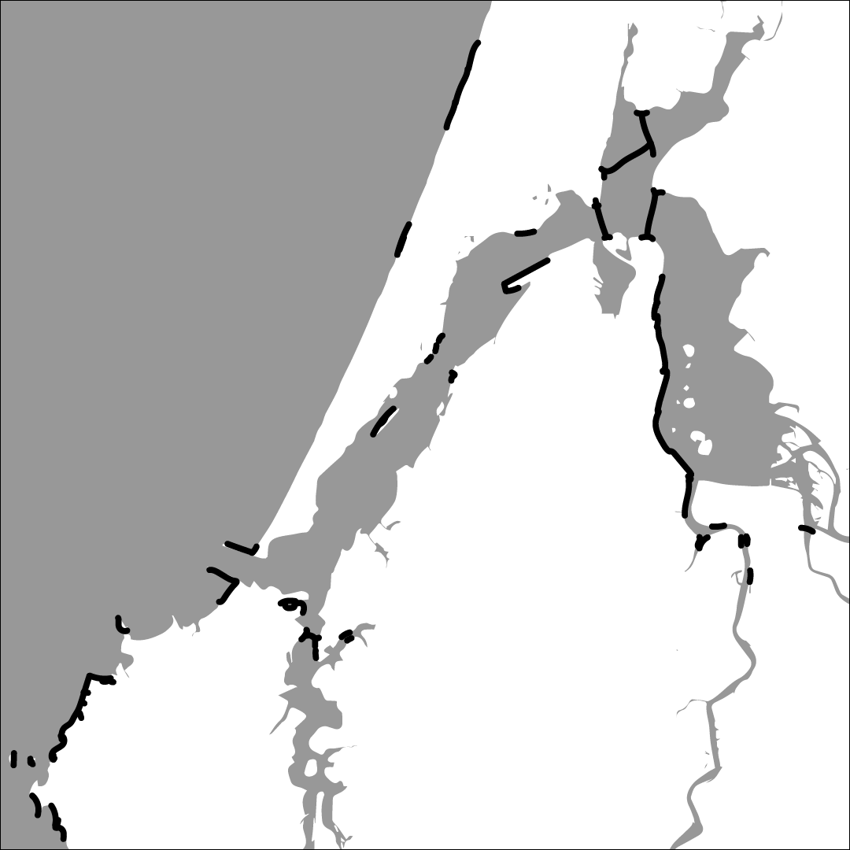
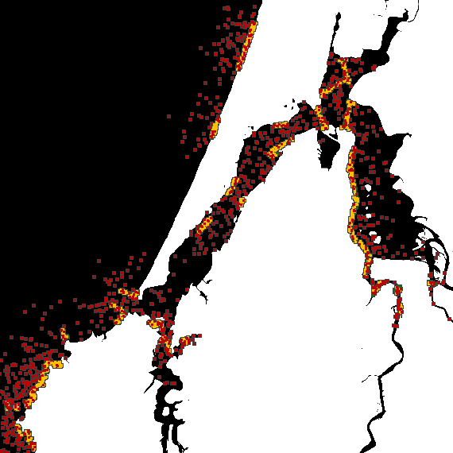
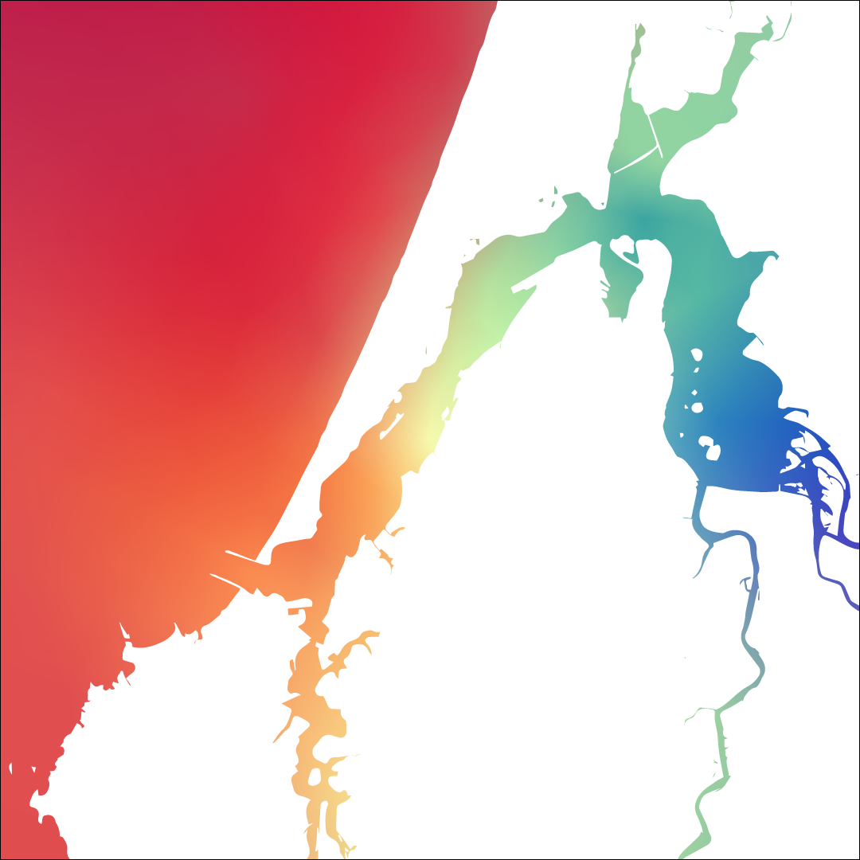
Build the model
How do we account for abiotic factors?
Coastline of Coos Bay, OR
+ Settlement Habitat
Observations by Craig Young
+ Salinity & Temperature
(Conroy et al., 2020) & (Marin Jarrin et al., 2022)
Larvae
Juveniles
Adults
Notes:
After we add in the most important aspects of barnacle biology, we have to work on the landscape
1. We start by laying out the coastline for Coos Bay, since we know barnacles live in the water (generally)…
2. When we run the sim with just this map, the barnacles are a little too everywhere
3. So next we set limitations on the habitat, since we know this species of barnacle can only settle on rocky shoreline in the intertidal zone…
4. Which leads to this more realistic distribution
5. We know there’s also variation of some abiotic factors, like salinity and temperature within the estuary,
6. meaning barnacles in the red and barnacles in the blue experience different environments

Slide 9
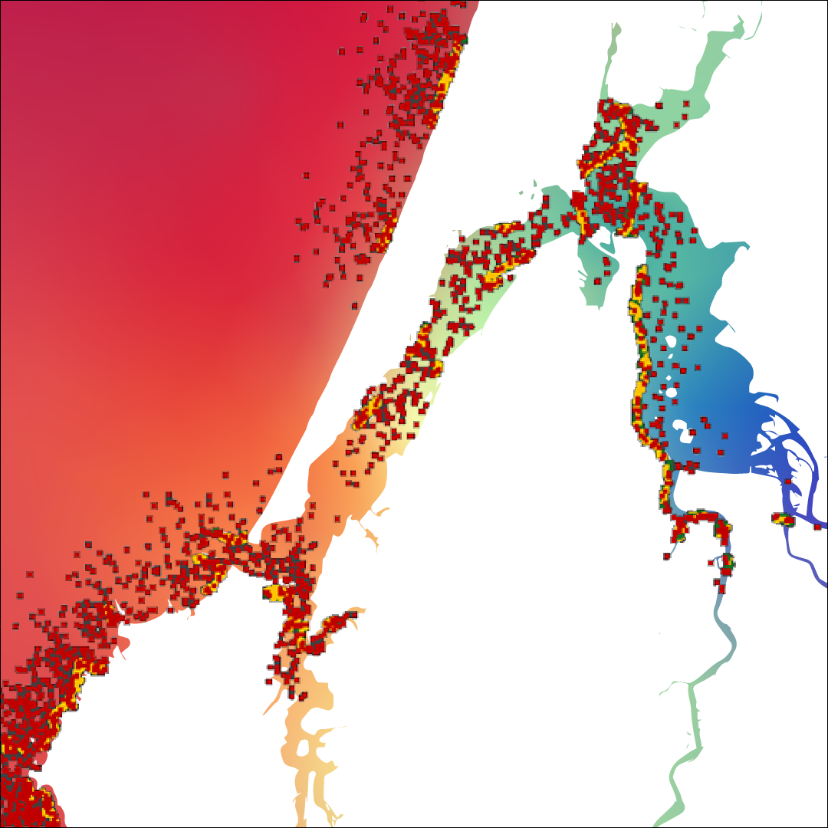

Build the model
The Role of Salinity and Temperature
(Berger et al., 2006)
(Berger, 2009)
Notes:
Well, what are the impacts of the differences?
Pulling from the current literature, we know that salinity and temperature impact multiple facets of barnacle biology
One relationship we account for salinity’s impact on juvenile survivorship. In our model, we see that juvenile barnacles do much better at mid to high salinities …
Another variable is temperature’s impact on adult fecundity. As we have implemented it, we see a general trend that adults produce larger broods when they are closer to the ocean
We use these relationships to model changes in population life stages and distribution (Show new map)

Slide 10
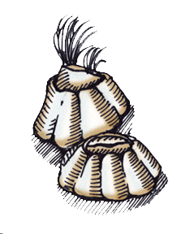
Build the model
Simulating local adaptation
We allow the modeled population to evolve!
We simulate mutations at a constant rate
These mutations produce a phenotype
Barnacle Phenotype
Notes:
- The last step in sculpting our barnacles is implementing genetic variation
We allow the modeled population to evolve
We simulate mutations at a constant rate we can control (Start mutation bar)
These mutations produce a phenotype (In this example that’s represented by the color of the barnacles)
From these phenotypes we model natural selection, where individuals are selected when their phenotype matches their environment

Slide 11
Build the model
Simulating local adaptation
We allow the modeled population to evolve!
We simulate mutations at a constant rate
These mutations produce a phenotype
Individuals are selected for when their phenotype matches their environment
Barnacle Phenotype
Notes:
…From these phenotypes we model natural selection, where individuals are selected when their phenotype matches their environment
(Start animation) Here, the barnacles whose colors don’t match the background die :(

Slide 12
Build the model
Simulating local adaptation
We allow the modeled population to evolve!
We simulate mutations at a constant rate
These mutations produce a phenotype
Individuals are selected for when their phenotype matches their environment
Barnacle Phenotype
Notes:
In the next generation, the phenotype of the new barnacles should match their environment
But, before settling we see some dispersal, which still results in some mismatch
When this occurs over many generations, this process is known as local adaptation and it’s one of the main ways a population survives in changing environments

Slide 13
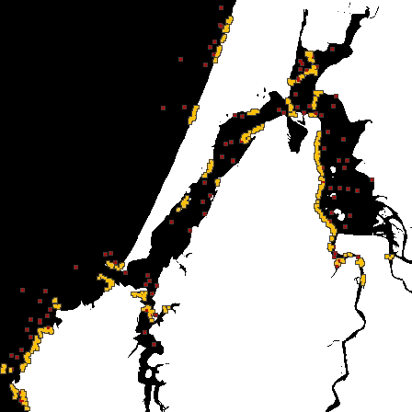
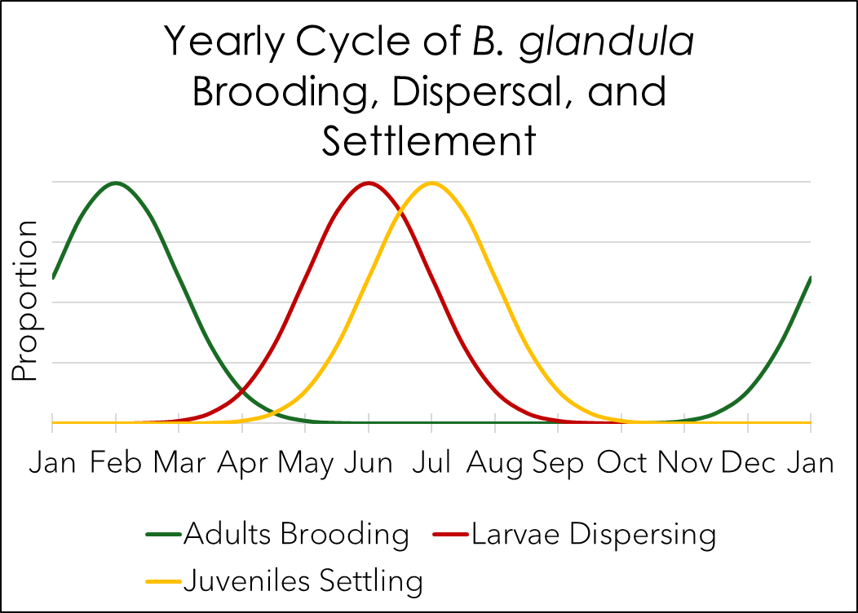
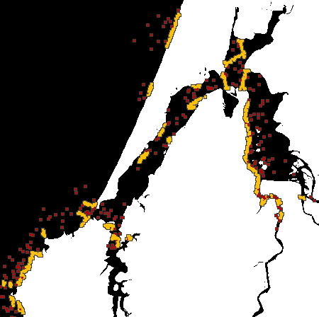
Use the model to test variation
Modeling Varied Reproduction
Continuous Reproduction
Seasonal Reproduction
Notes:
With the sculpting done, we’ve started to run experiments with our model
The first things we tested was the effect of seasonal reproduction on population size
As you might recall, I mentioned there’s a time component to reproduction, dispersal, and settlement. Current literature states that larval dispersal and settlement are generally limited to the summer
Here are two simulations, one where reproduction occurred year-round and one where it was seasonally-restricted.
Notice that this results in burst of larval dispersal, before they population contracts due to limited settlement habitat
When we plot population size over time, we see the same trend. The seasonal reproduction sim, in blue, has cycles of population growth and contraction. The continuous reproduction, in orange, is more stable…
And we regardless of the reproductive window both populations reach the same upper limit of carrying capacity.
We expect to see these results, but they serve as a good test that the model’s working as expected.

Slide 14
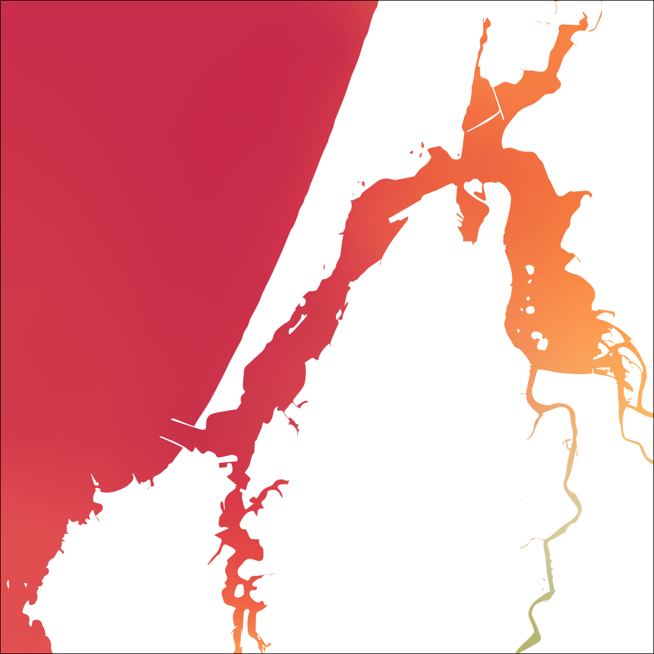
We’ve built the model! What’s Next?
Use the model to test variation
Short-term: seasonal salinity and temperature
Long-term: increasing temperature according to climate models
Examine how populations adapt to changing environments
Winter Salinity & Temp
Summer Salinity & Temp
(Conroy et al., 2020) & (Marin Jarrin et al., 2022)
Notes:
So, what’s next? This is an ongoing project, and we have plenty of plans for where to take this
Expanding on our tests of varied reproduction, our next goal is to implement other components of variation.
In the short-term, we’ll implement seasonal salinity and temperature…
and in the long-term, we’ll implement broader changes to the climate
Once we do that, we’ll examine how our barnacle population can evolve and adapt in response to these conditions, modeling the effects of Anthropogenic Climate Change

Slide 15
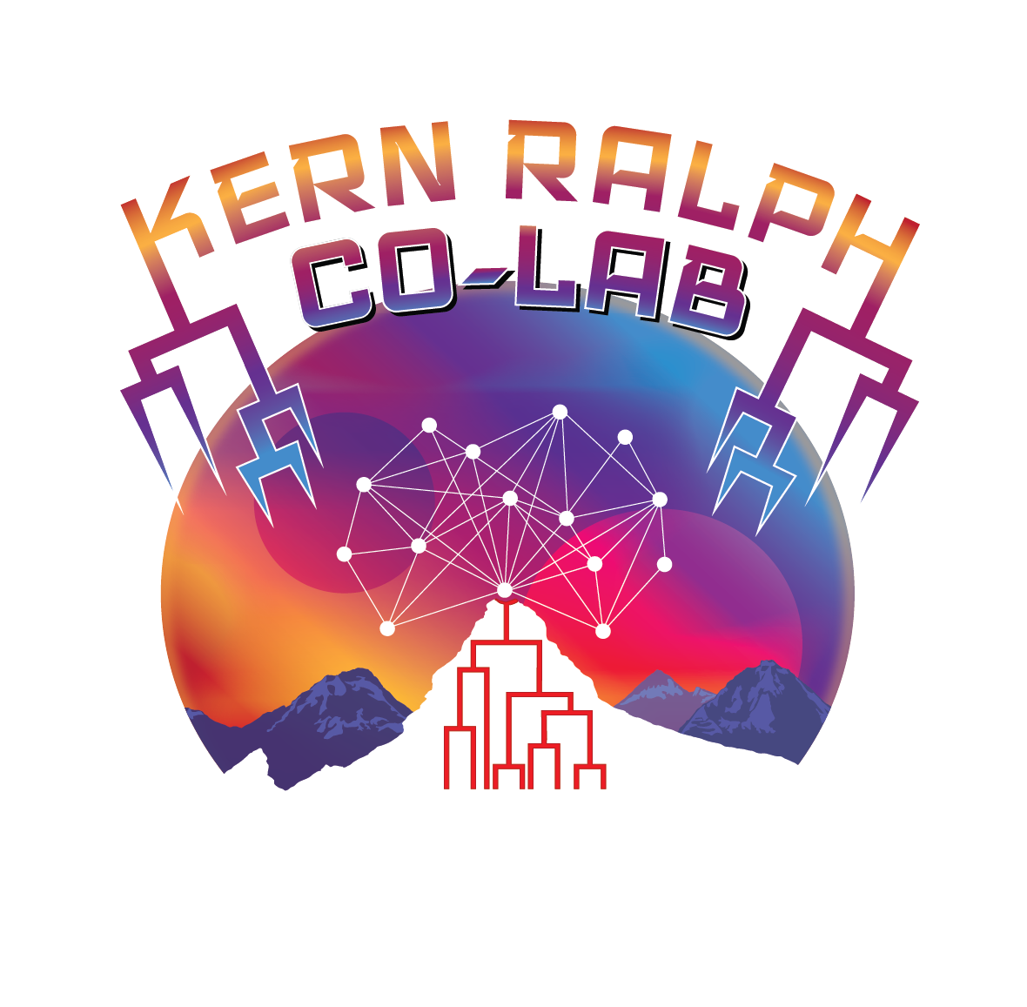
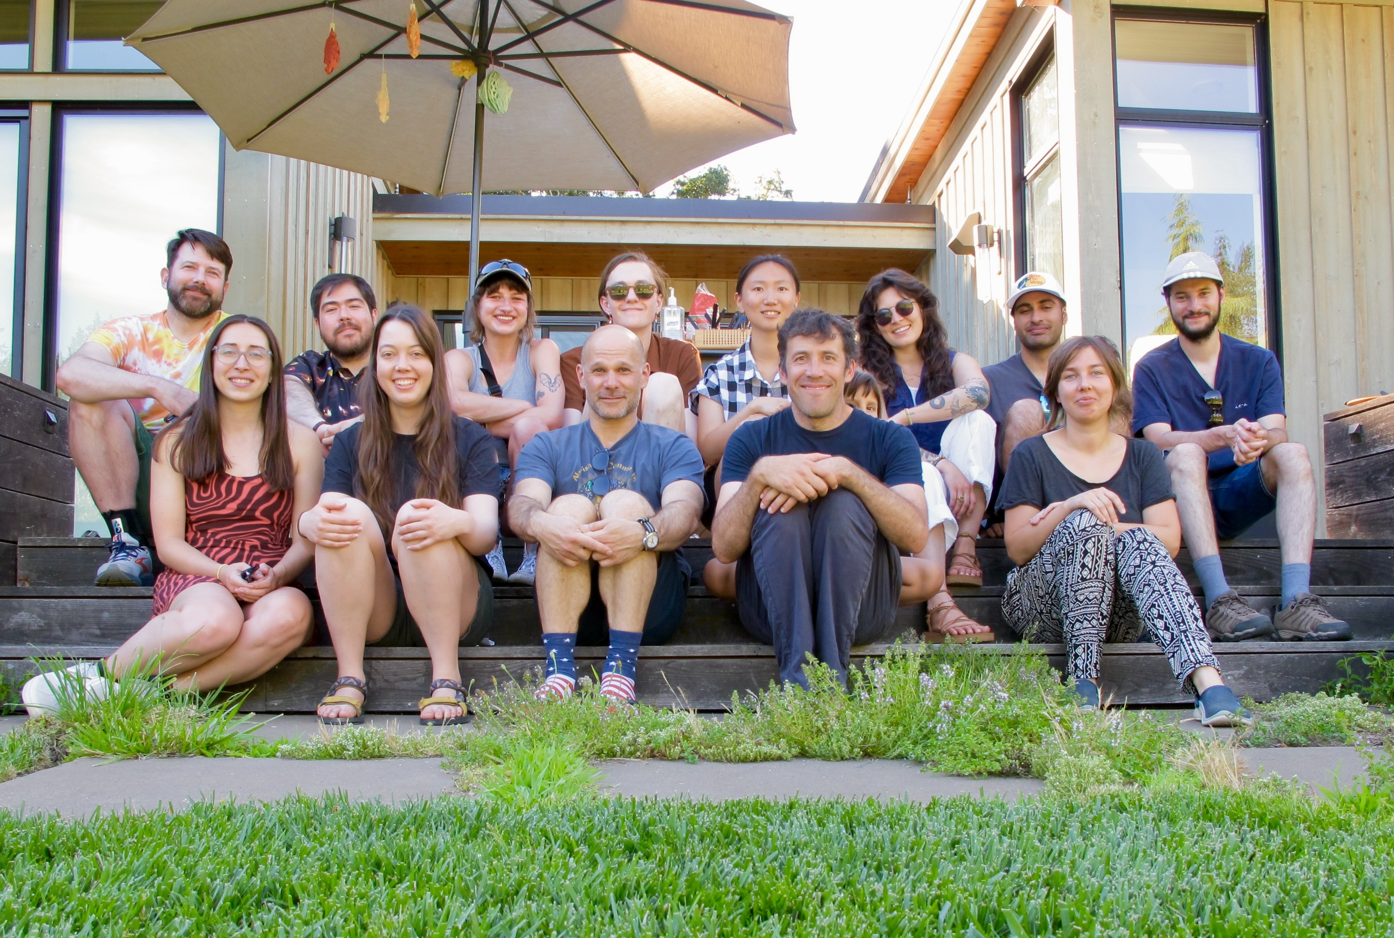

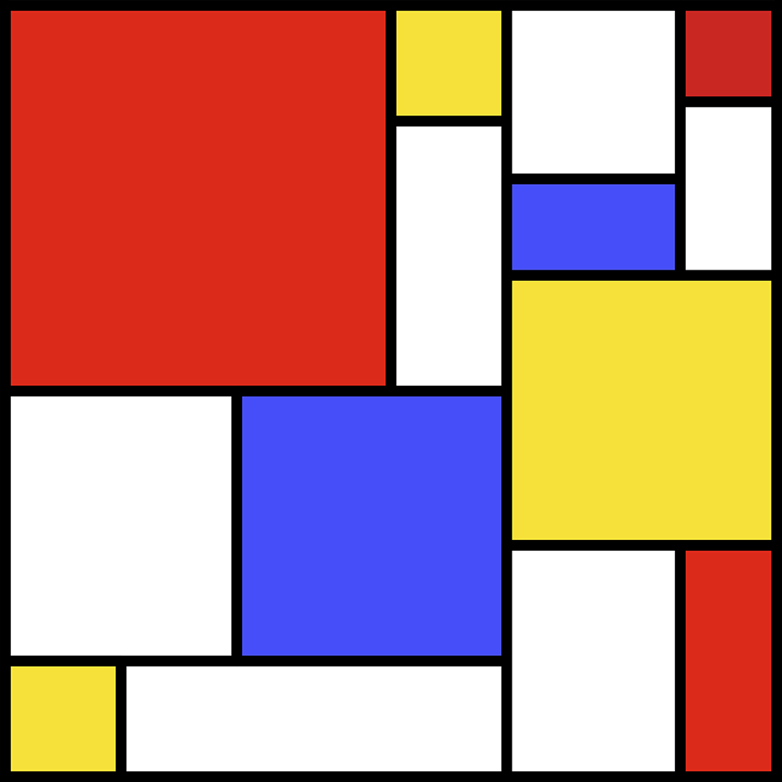
Acknowledgements and References
Thank you to
The entirety of the Kern Ralph Co-Lab for being a wonderful group to collaborate and research with.
Erin Jezuit at OIMB for your help sampling, photographing, and analyzing B. glandula samples.
Ben Haller and Philipp Messer for the development of SLiM: An Evolutionary Simulation Framework.
The University of Oregon Summer Program for Undergraduate Research and the Mary G. Alden Fellowship for the opportunity to pursue summer research.
Berger, M. S. (2009). Reproduction of the Intertidal Barnacle Balanus Glandula Along an Estuarine Gradient. Marine Ecology, 30(3), 346–353. https://doi.org/10.1111/j.1439-0485.2009.00280.x
Berger, M. S., Darrah, A. J., & Emlet, R. B. (2006). Spatial and temporal variability of early post-settlement survivorship and growth in the barnacle Balanus glandula along an estuarine gradient—ScienceDirect. Journal of Experimental Marine Biology and Ecology, 336(1), 74–87.
Conroy, T., Sutherland, D. A., & Ralston, D. K. (2020). Estuarine Exchange Flow Variability in a Seasonal, Segmented Estuary. Journal of Physical Oceanography, 50(3), 595-613, 50(3), 595–613.
Haller, B. C., & Messer, P. W. (2023). SLiM 4: Multispecies Eco-Evolutionary Modeling. The American Naturalist, 201(5), E127–E139. https://doi.org/10.1086/723601
Hiebert, T. C., & Jarvis, M. (2015). Balanus glandula. In Oregon Estuarine Invertebrates: Rudys’ Guide to Common Species (3rd ed., pp. 574–580). University of Oregon Libraries and Oregon Institute of Marine Biology.
Marin Jarrin, M. J., & Sutherland, D. A. (2022). Wind Effects on the Circulation of a Geometrically-Complex Small Estuary. Estuarine, Coastal and Shelf Science, 278, 108092. https://doi.org/10.1016/j.ecss.2022.108092
Matz, M. V., Treml, E. A., & Haller, B. C. (2020). Estimating the potential for coral adaptation to global warming across the Indo-West Pacific. Global Change Biology, 26(6), 3473–3481. https://doi.org/10.1111/gcb.15060
Suárez-Morales, E. (2015). Chapter 29—Class Maxillopoda. In J. H. Thorp & D. C. Rogers (Eds.), Thorp and Covich’s Freshwater Invertebrates (Fourth Edition) (pp. 709–755). Academic Press. https://doi.org/10.1016/B978-0-12-385026-3.00029-2
Notes:
Thank YOU for coming!
And thanks to the Kern Ralph Co-Lab for being a wonderful research environment
To Erin Jezuit for being our Coos Bay Liaison
And to SPUR and the Mary G. Alden Fellowship for the opportunity to pursue this research

Slide 16
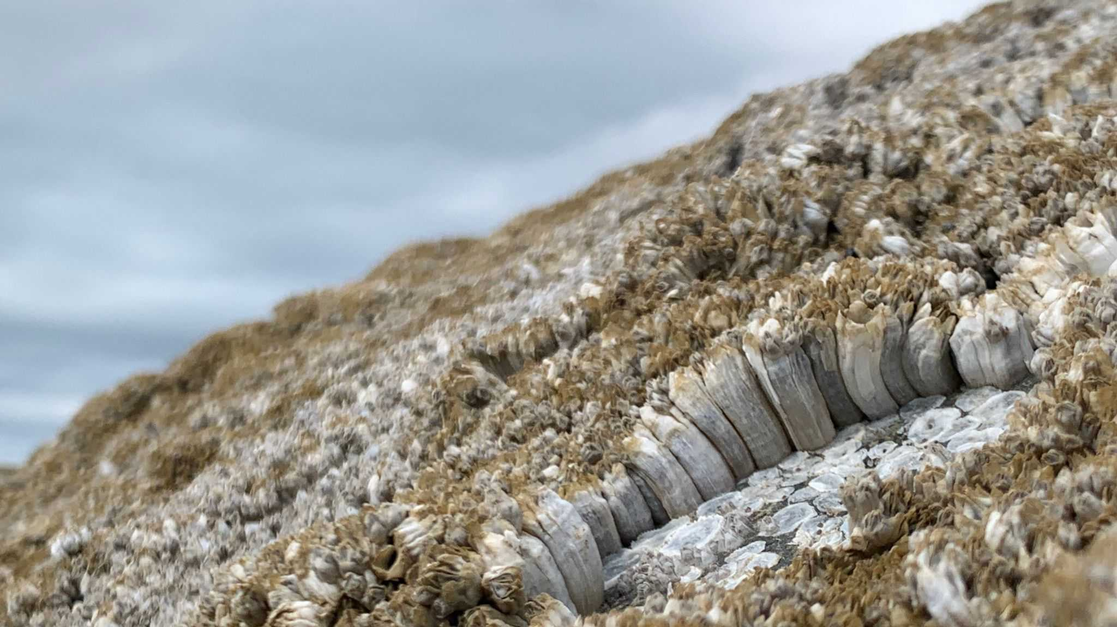
Questions?
Credit to Alida de Flamingh, 2024

